Slide 1
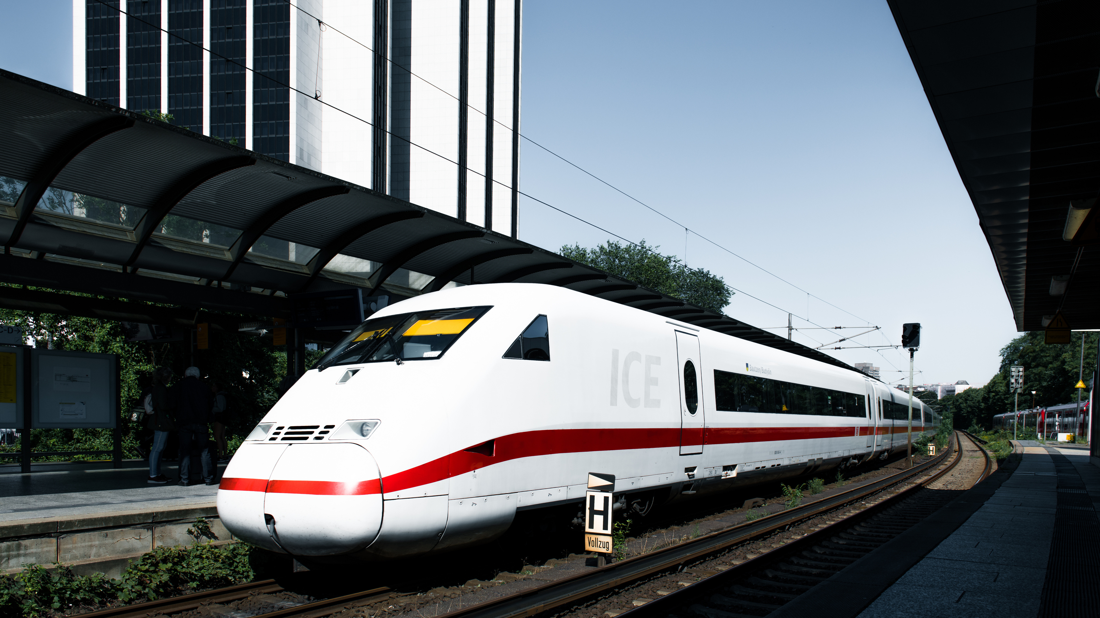

Graduation Project
Data Analysis for UK Train Project
Presented by the Data Insights Team

Slide 2




TEAM ONE
Meet Our
Team
Meet the people who built the success

Slide 3







OUR TEAM MEMBERS
Israa Ahmed Helmy
Lilian Ezzat
Esraa Yasser
Ahmed Gamal
Mostafa Hossam
Mohab Fekry

Slide 4

01
Team Members
02
Project Overview
03
Project Idea
04
Original Dataset
05
Project Process
06
Data Cleaning
07
DAX , Measures
08
Modeling
09
Visual Sample
10
Dashboard Skeleton

Slide 5
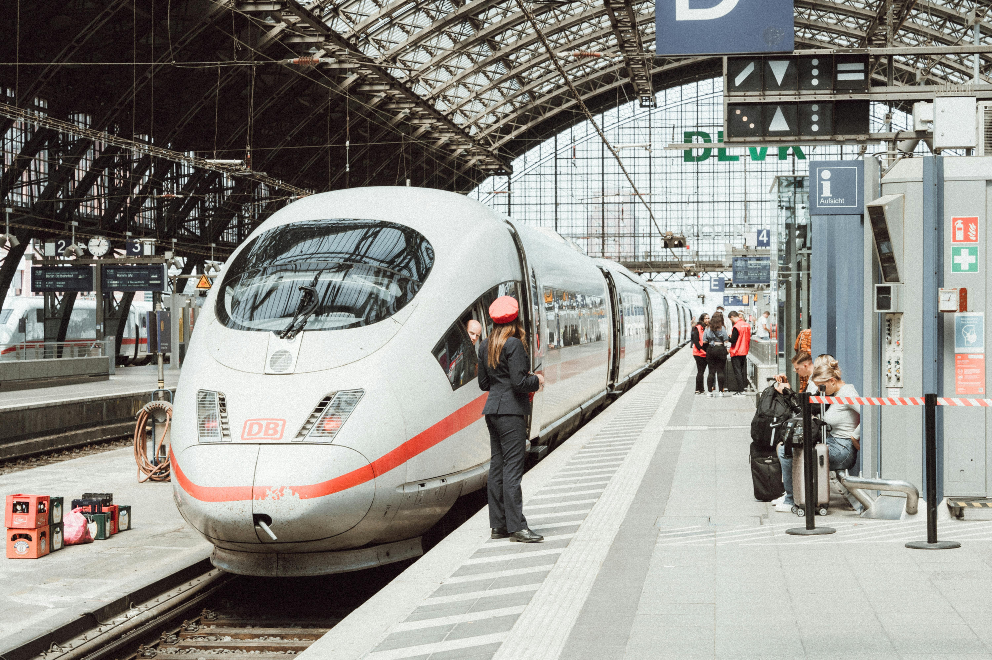
Project
Overview
This project analyzes railway ticketing and journey data to understand passenger booking behavior, ticket sales, and train performance.
It covers details such as purchase type, payment methods, ticket classes, prices, stations, journey times, and delays. The goal is to gain insights into customer preferences, revenue patterns, punctuality, and reasons for delays, while also exploring opportunities for improving efficiency, predicting demand, and enhancing the passenger experience.

Slide 6




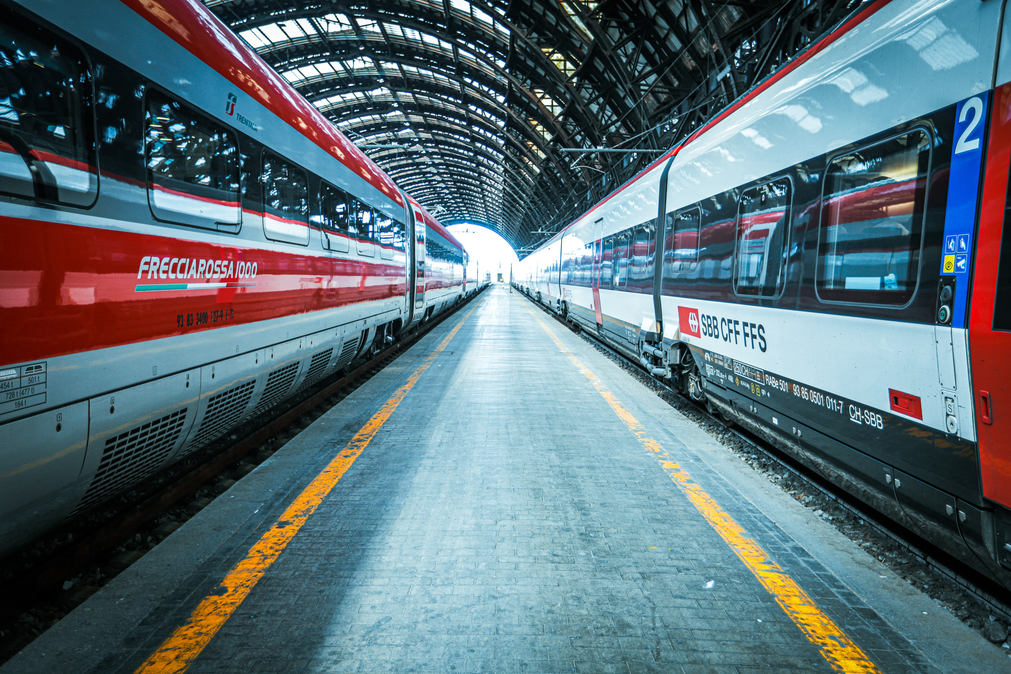
Problem
Project Idea
Train passengers in the UK frequently face delays, cancellations, and inconsistent service quality.
These issues negatively impact passenger satisfaction and operational efficiency.
Without clear data insights, identifying root causes and performance patterns is challenging.
Solution
Developed an interactive Power BI dashboard analyzing 31,653 real-world train booking records.
Provides insights into ticket sales, peak travel times, delay patterns, refund trends, and passenger behavior.
Empowers decision-makers to improve service delivery and operational efficiency.
Unique Value
Transforms complex railway data into an intuitive, decision-focused dashboard.
Designed for both technical and non-technical users.
Addresses business pain points, reduces losses, and enhances customer satisfaction through evidence-based decisions.

Slide 7
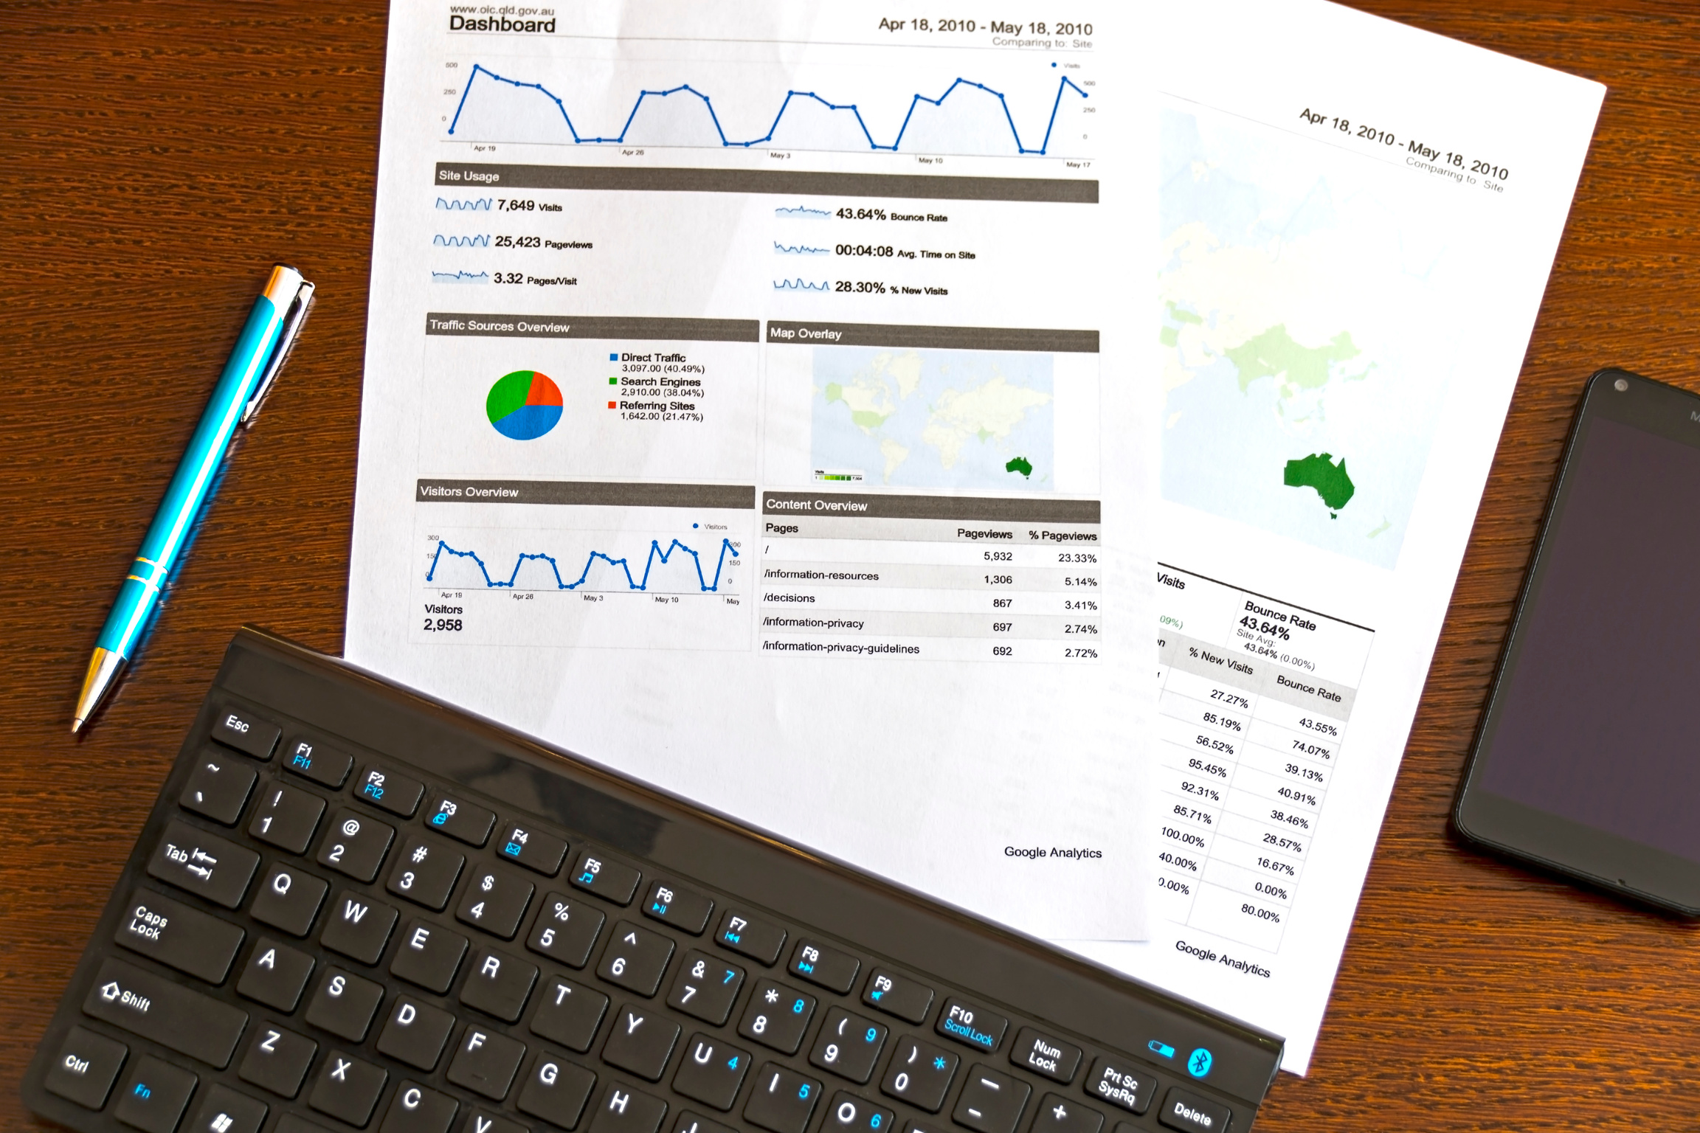
Original Dataset
Source: Raw CSV dataset
Transaction ID
Price
Dates: Date of Purchase, Date of Journey as date
Times: Time of Purchase, Departure Time, Arrival Time, Actual Arrival Time as time
Categorical: Purchase Type, Payment Method, Railcard, Ticket Class, Ticket Type, Departure Station, Arrival Destination, Journey Status, Reason for Delay, Refund Request
DATA INSIGHTS OVERVIEW

Slide 8












The process of preparing raw data by removing errors, duplicates, missing values, and inconsistencies to ensure the dataset is accurate, reliable, and ready for analysis.
Claening
Project Process
Structuring the cleaned data into logical tables and defining relationships between them. This step ensures that the data model supports efficient analysis and accurate reporting.
Modeling
The project process transforms raw data into insights by cleaning and modeling it, applying DAX calculations, creating sample visuals, building a detailed report, and delivering an interactive dashboard for decision-making.
DAX & Measures
Using Data Analysis Expressions (DAX) to create calculated columns, measures, KPIs, and business logic that enhance analytical capabilities within Power BI.
Creating charts and visual elements that represent key insights. These prototypes help validate the data model and ensure alignment with business requirements.
Sample Visual
Report
A structured collection of visuals, KPIs, and insights organized into one or more pages. The report communicates findings and provides a deeper understanding of the data.
A high-level, interactive view that combines selected visuals (often from multiple reports) into a single monitor page, providing quick access to essential business metrics.
Dashboard

Slide 9
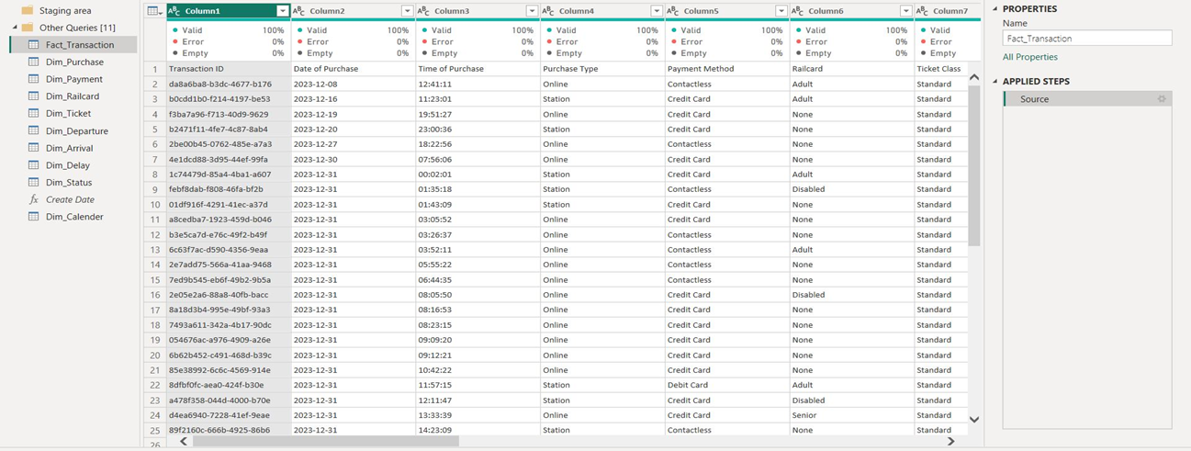

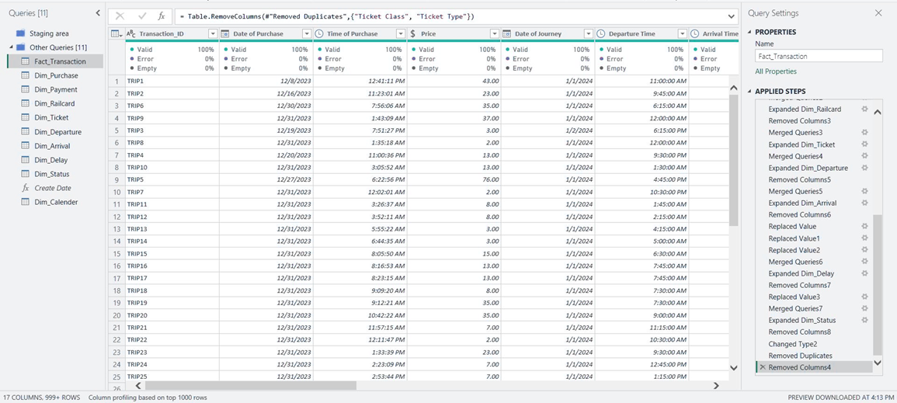
Data Cleaning
Before
After

Slide 10
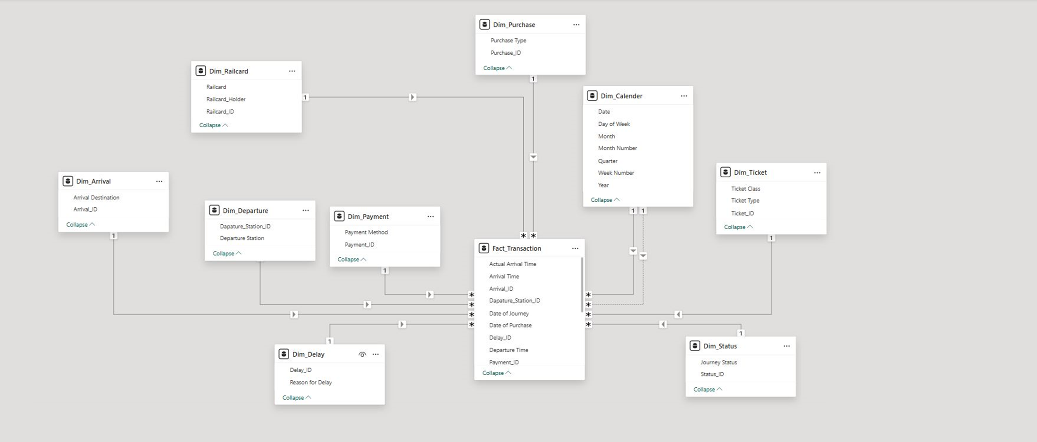
Data Modeling

Slide 11
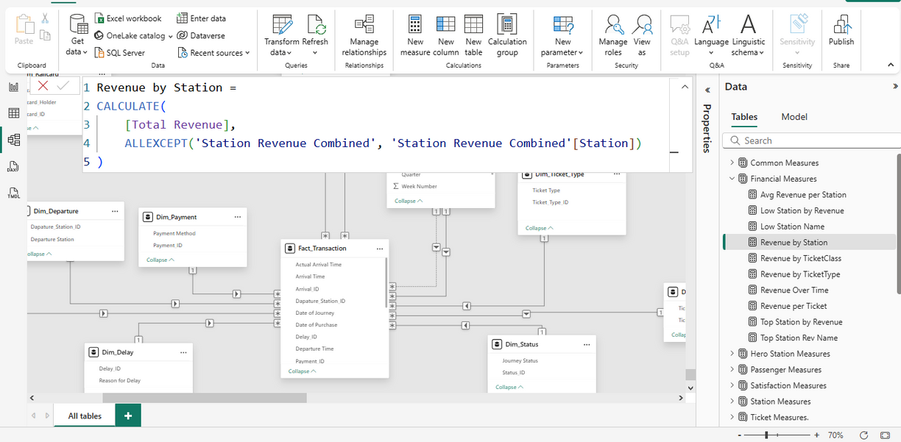

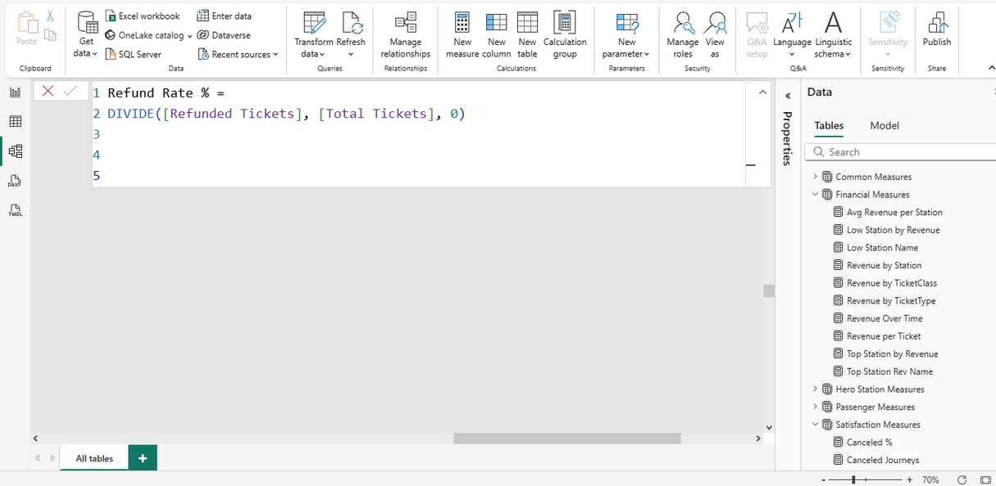
DAX
Measures
DAX formula to get Revenue per station
DAX formula to get refund rate

Slide 12
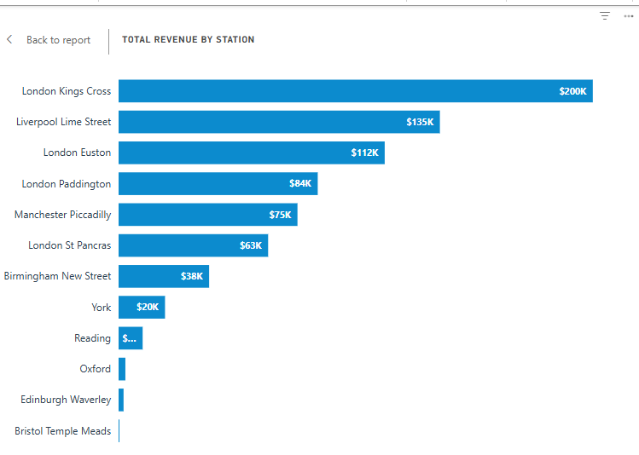
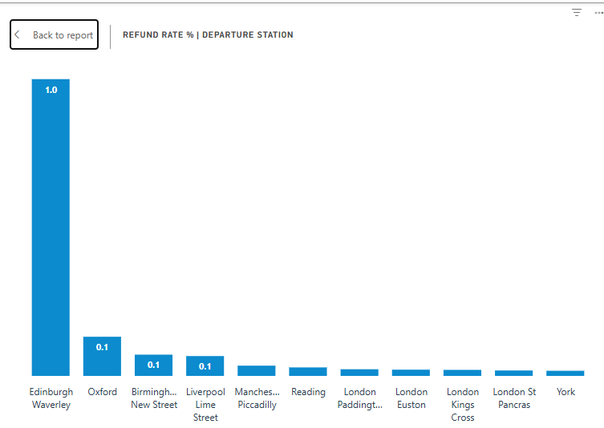
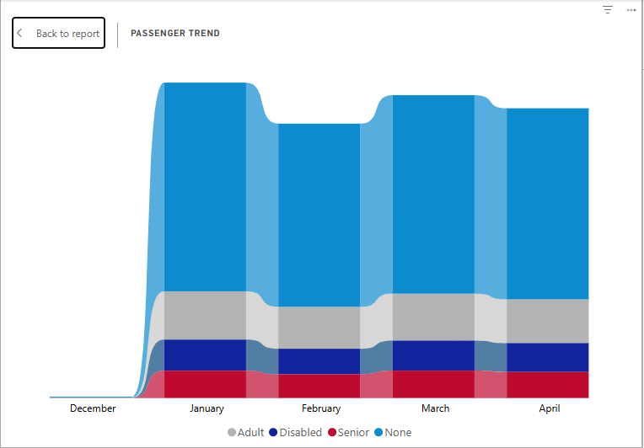
Visual
Sample
Stacked bar chart showing the Total revenue generated by station name
Stacked Column chart showing Refund rate per departure station name
Ribbon chart showing passenger trend over monthly view

Slide 13












Dashboard Skeleton
Ticket Analysis
Station Analysis
Financial Analysis
Passenger Analysis
Complaint & Customer Satisfaction
Hero Station
What is the distribution of ticket types sold (e.g., Anytime, Off-Peak)?
Which ticket class generate the highest revenue?
What is the average ticket price per route or station?
How do ticket sales vary by time (day/week/month)?
What is the refund rate and its reasons?
Which stations have the highest passenger traffic?
What is the average delay per station?
Which stations have the most complaints?
What is the revenue generated per station?
Are there seasonal or time-based patterns in station usage?
What is the total revenue and cost breakdown?
Which ticket types or stations are most profitable?
What is the refund impact on revenue?
How does revenue trend over time?
What is the revenue per passenger or per journey?
What are the demographics of passengers (age group, railcard usage)?
How many passengers travel with railyards vs. without?
What are the most common journey patterns by passenger type?
How does passenger volume change over time?
Which customer segments are growing or declining?
What is the passenger volume and revenue for this station?
What are the top routes and ticket types used here?
What is the delay and complaint rate at this station?
How does this station compare to others in performance?
What are the satisfaction scores and feedback trends?
What are the most frequent complaint categories?
Which stations or ticket types receive the most complaints?
What is the resolution rate of complaints?
How does customer satisfaction vary by journey type or station?
Are there trends in complaints over time?
Dashboard

Slide 14

Journey
Conclusion
Operations:
Optimize train schedules, staffing, and crowd flow at busy stations.
Reallocate resources from low-performing stations.
Fix delays by addressing technical, weather, and operational issues.
Add more trains in peak seasons.
Customer & Refund Management:
Offer zero-fee ticket exchanges instead of refunds.
Apply tiered penalties for cash refunds.
Contact refund-request customers and resolve their issues.
Fix online payment problems and provide clear user instructions.
Improve communication and automate refunds.
Revenue & Ticketing:
Enhance the Advanced Ticket type.
Review off-peak ticket policies.
Run offers during low season.
Hero Station
Improve digital purchase experience.
Increase First Class attractiveness.
Target Railcard holders with loyalty campaigns.
Reduce human-caused delays.

Slide 15
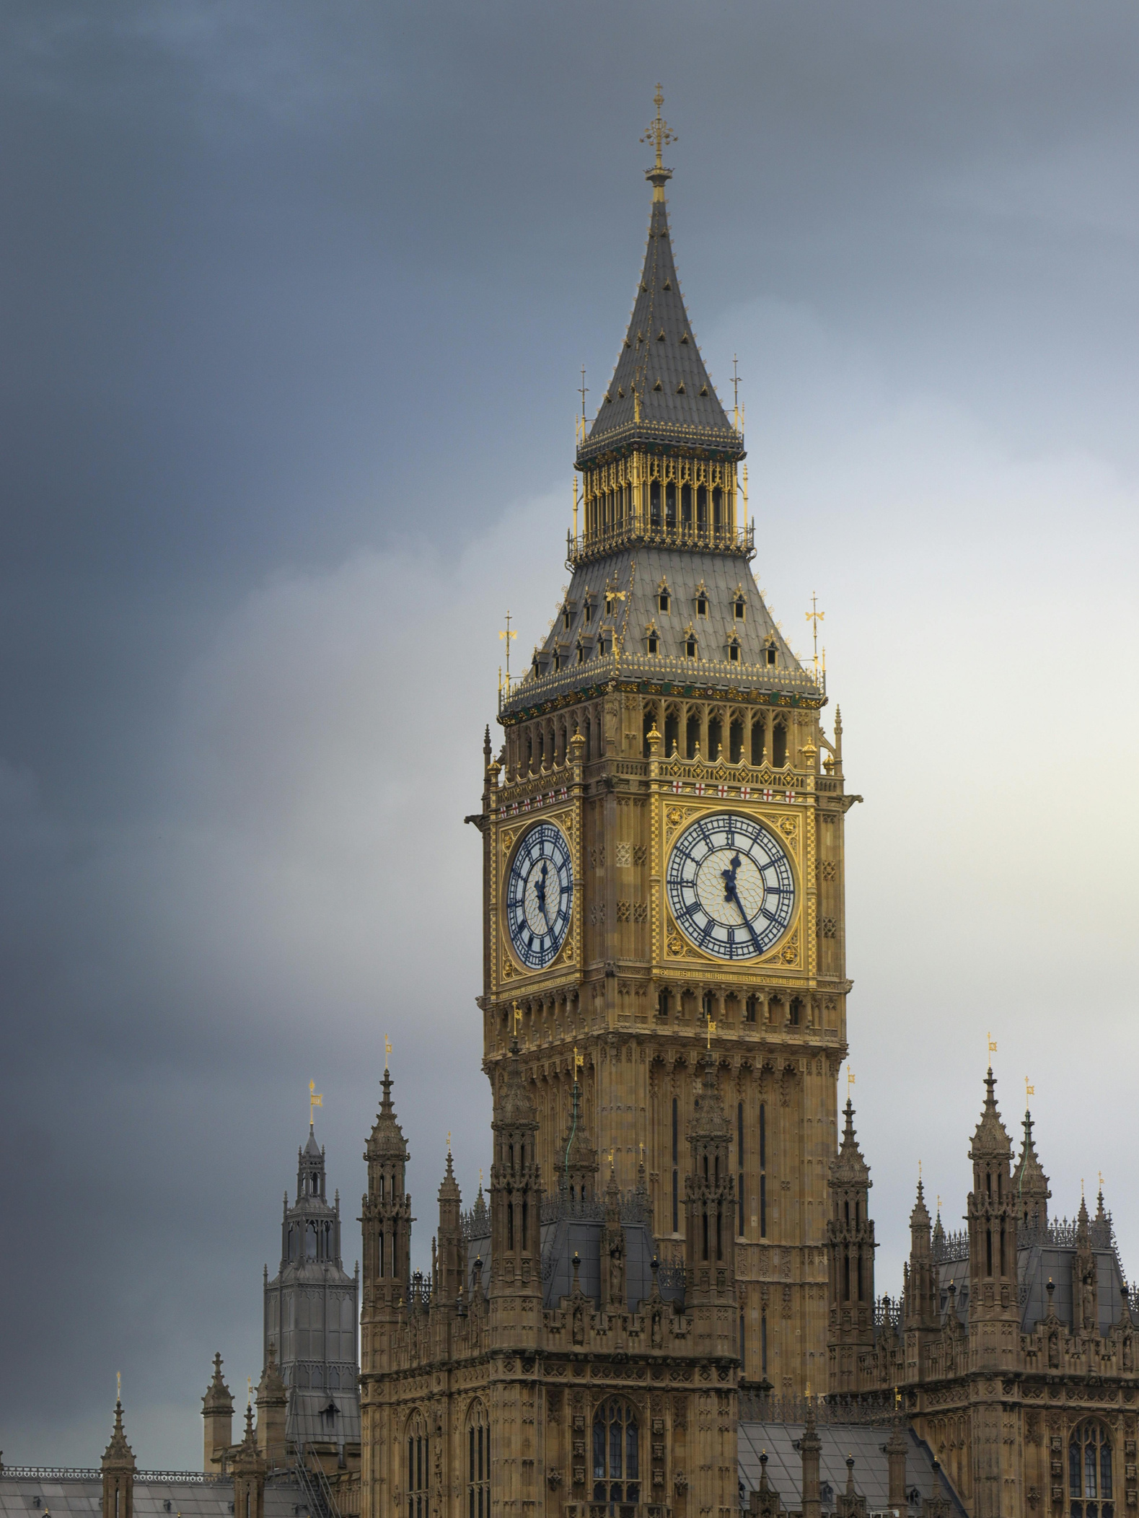
Thanks

